Slide 1
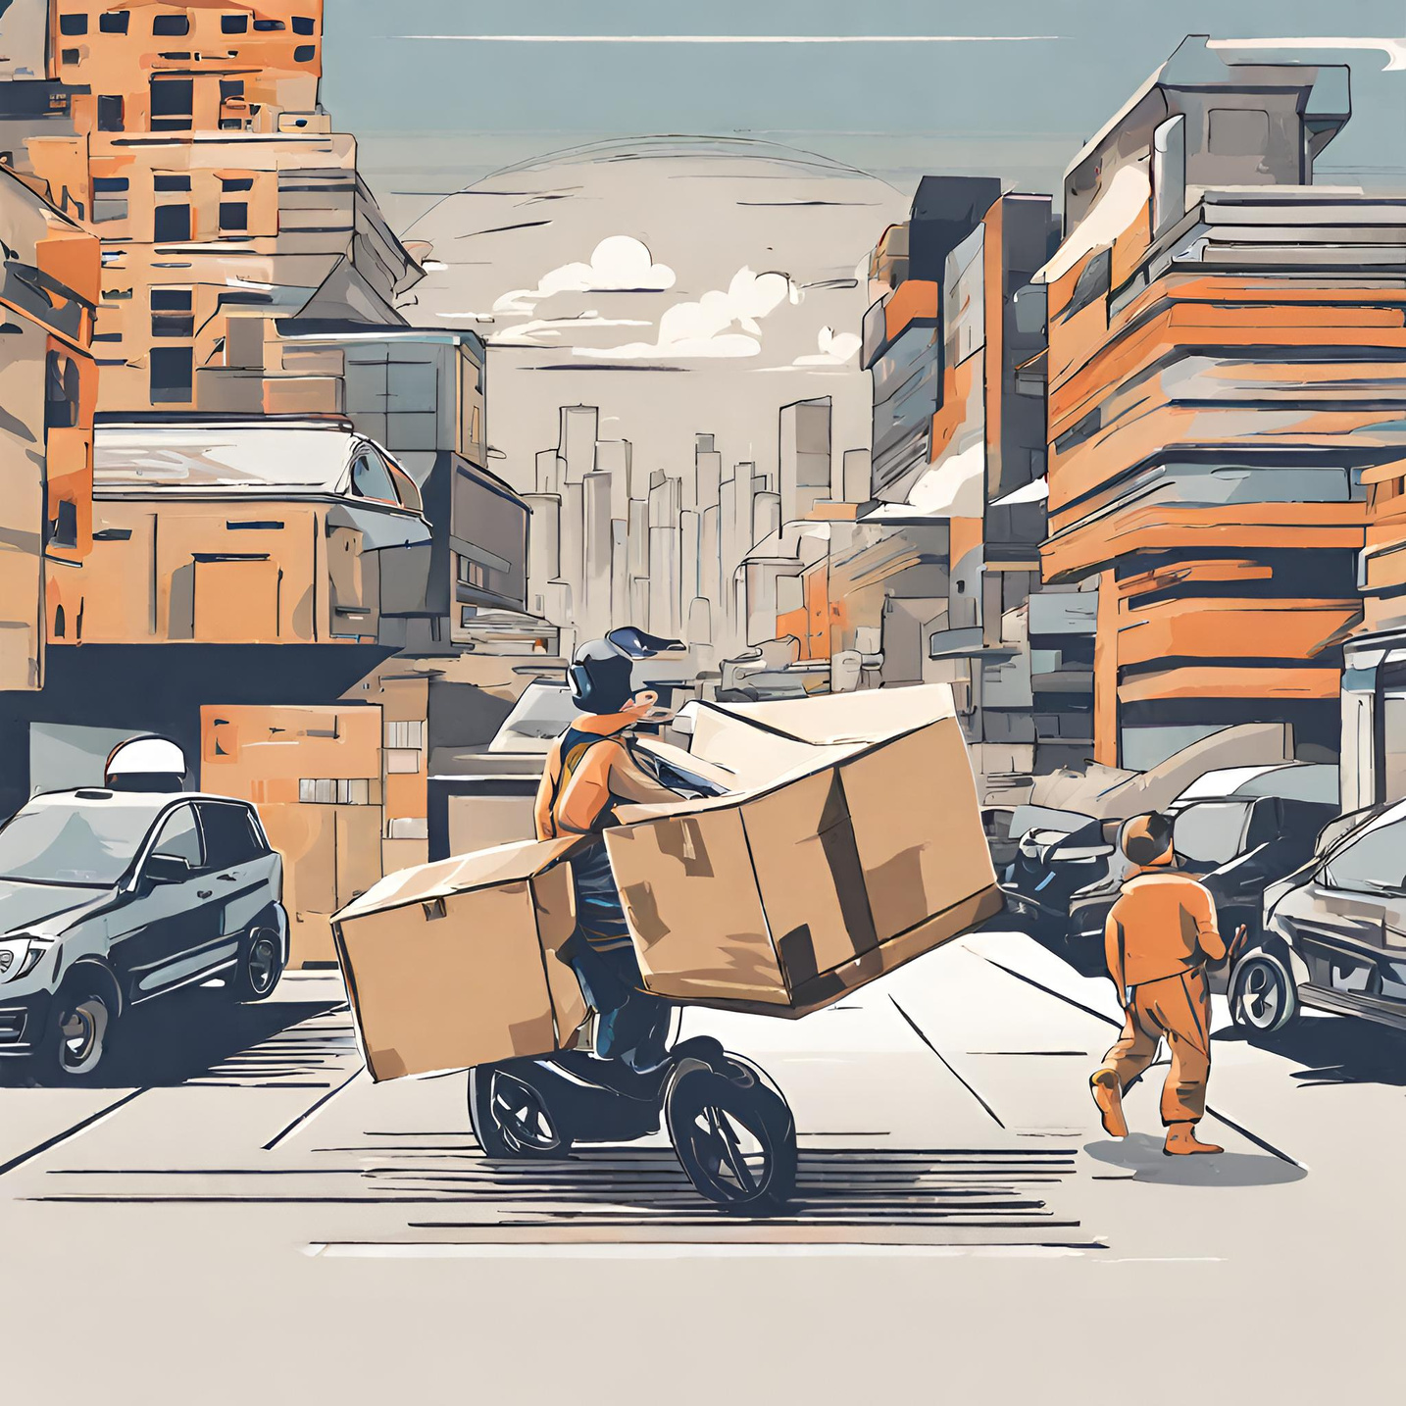




ICT IGNITE
DATA ANALYSIS
HTTPS://RETURN-PAL.VERCEL.APP/

Slide 2


CONTENT
01
02
03
​
Problem Statement
Timeline
Tools and Techniques​
04
05
06
Need of the Project
Descriptive Analysis
EDA

Slide 3



PROBLEM STATEMENT
ReturnPal wants to explore potential growth areas within its industry and diversify its services to meet emerging customer demands.
ReturnPal requires data-driven insights to make informed strategic decisions about its future business direction and expansion efforts.

Slide 4
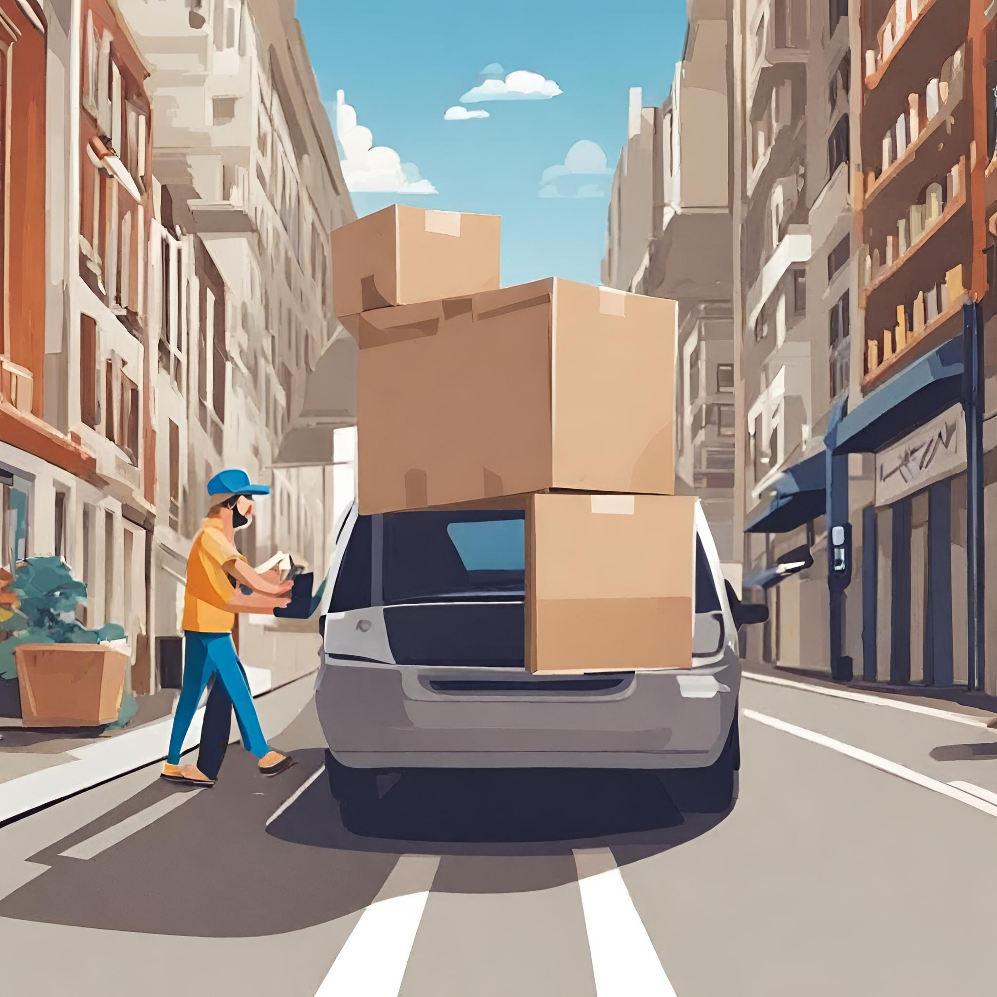



TIMELINE
Initiation
Finding dataset and cleaning
Aggregation
Visualization
Team building, finding the project, meeting with the stackholders, understanding the requirements.
6th September 2023 to 15th September 2023
Aggregate the multiple datasets, find the relation ship among the data
16th November 2023 to 15th February 2024
Create the visualtization using tableau.
16th February 2024 to 28th February 2024
Finding the dataset, cleaning
15th september 2023 to 15th November 2023

Slide 5



TOOLS AND TECHNIQUES​
Tableau
Python
SQL

Slide 6





NEED OF THE PROJECT
01
02
Data-Driven Decision Making
Operational Efficiency
ReturnPal needs to leverage data analysis to guide its business strategy and stay competitive.
Identifying and addressing operational inefficiencies can lead to cost savings, improved customer service, and enhanced business processes. Streamlining operations is essential for long-term success.
03
04
05
RETURNPAL
Financial Optimization
Competitive Advantage
Learning and Portfolio Building
Efficiently managing the financial impact of returns is crucial for the company's profitability. This project can help ReturnPal better understand the financial implications and develop effective strategies.
In a competitive e-commerce landscape, staying ahead of industry trends and emerging customer demands is essential. This project enables ReturnPal to anticipate and capitalize on future opportunities.
This project provides learners with valuable real-world experience, enhancing their skillset and allowing them to build a portfolio of work that can benefit their future careers.

Slide 7
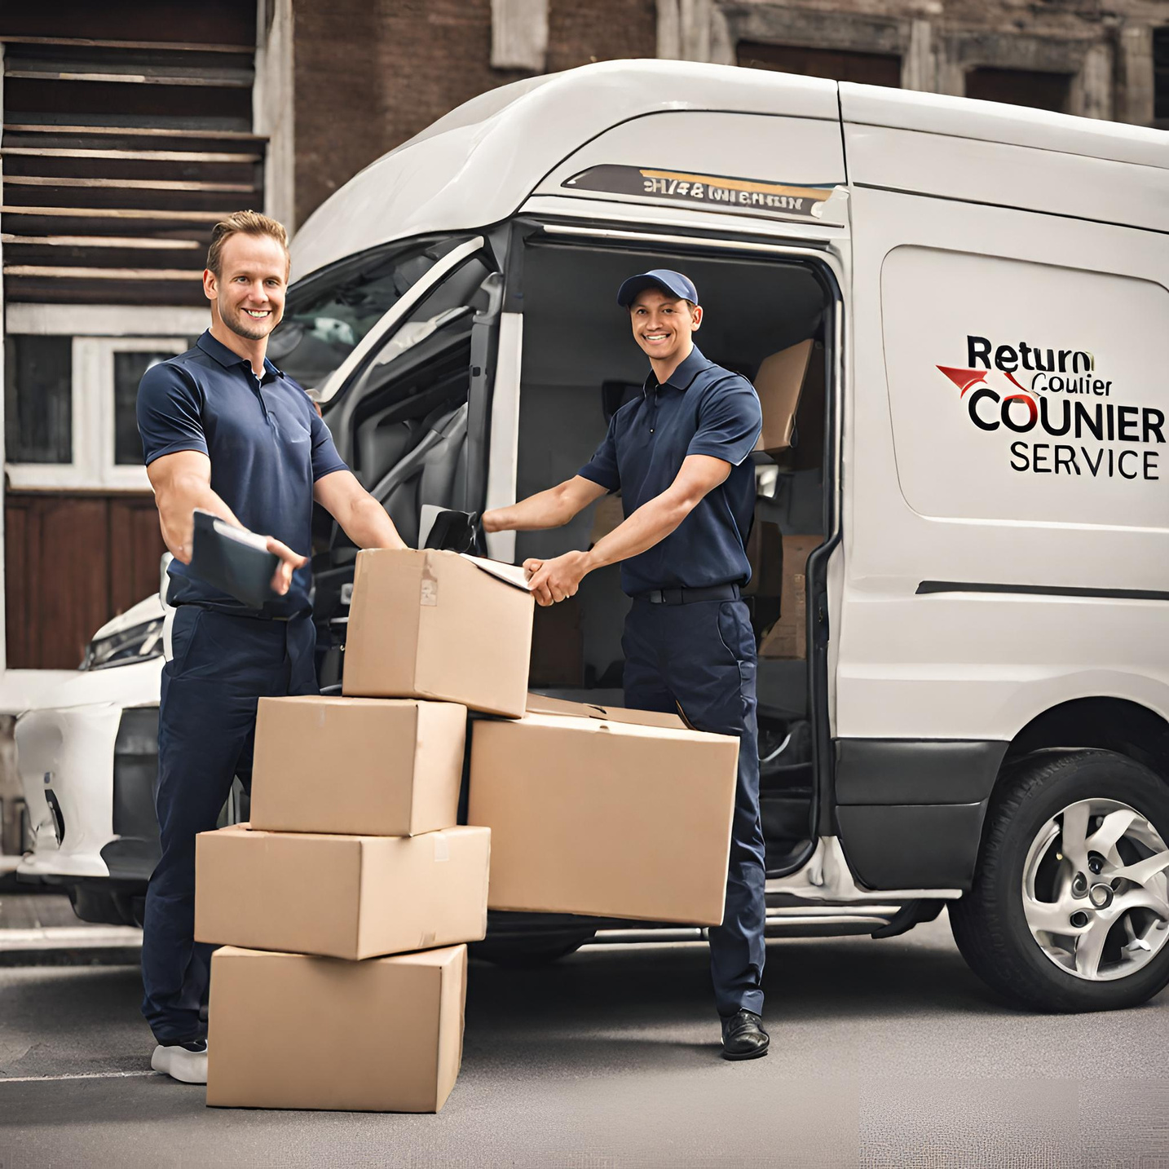



DESCRIPTIVE ANALYSIS
What is the distribution of return rates across different product categories or customer segments?
What are the seasonal trends in returns, and can we correlate them with specific events or changes in the business environment?
Are there any specific products or product categories that are more commonly associated with returns? Can we segment customers based on their preferences for these products?

Slide 8

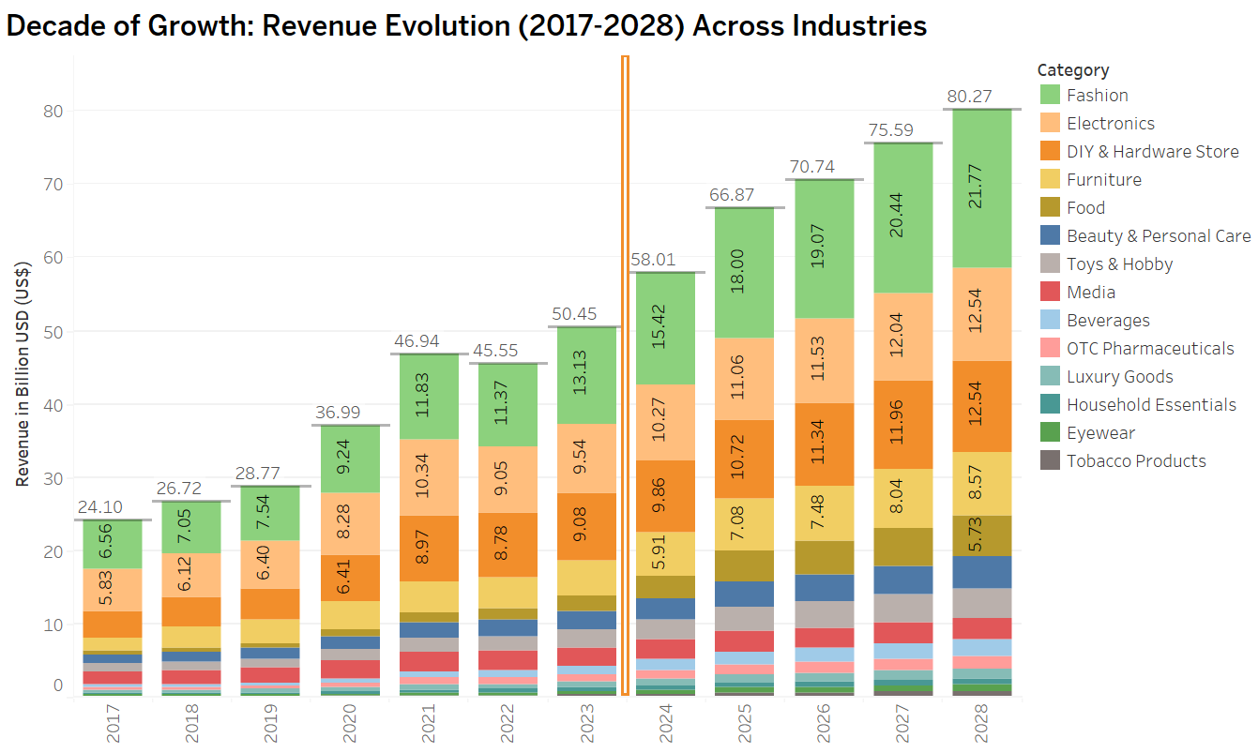
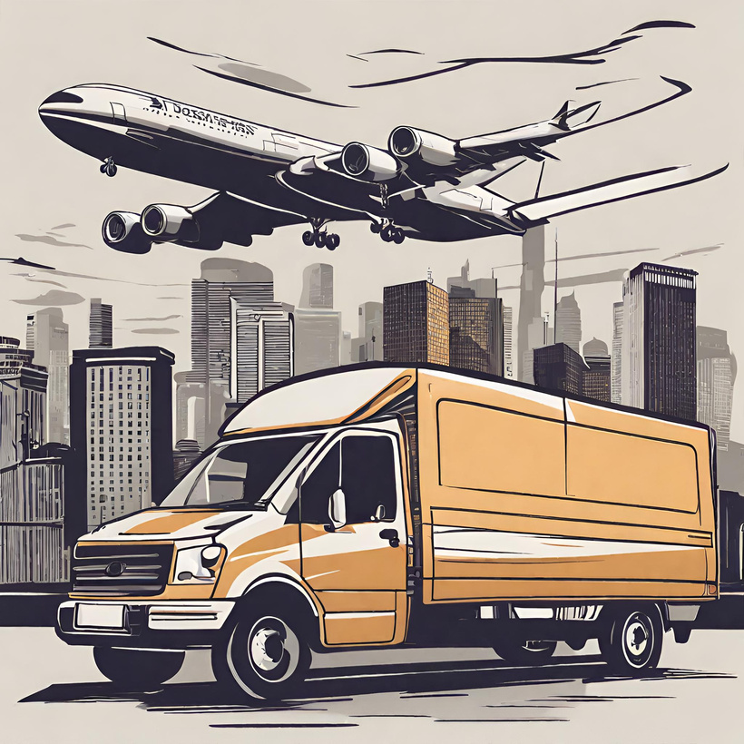
EDA 1

Slide 9
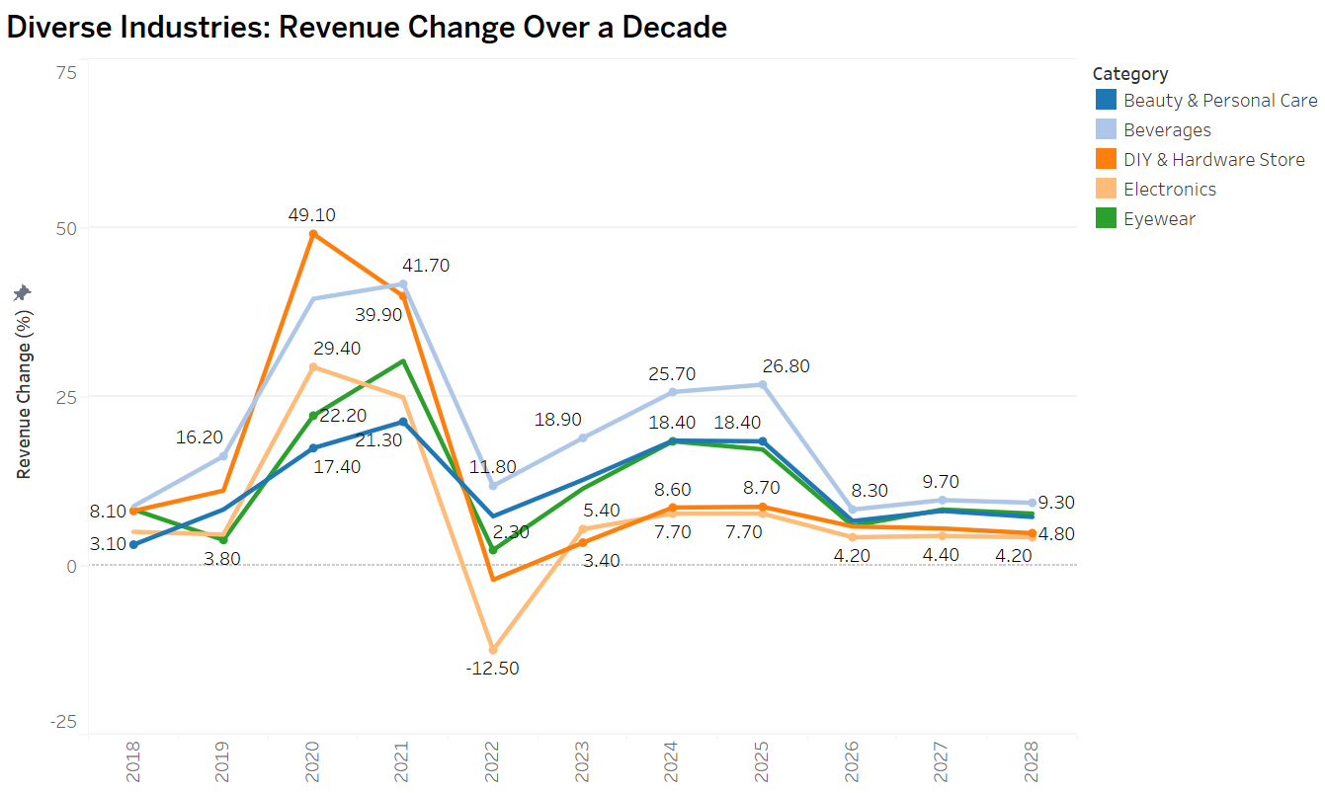
EDA 2

Slide 10
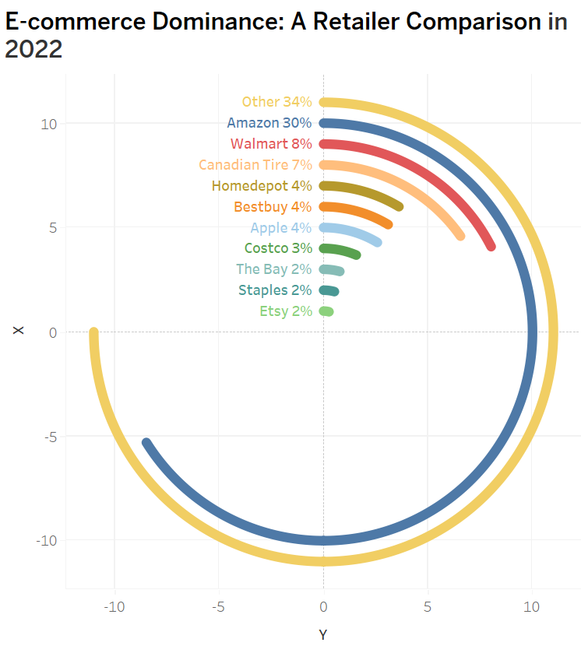
EDA 3

Slide 11
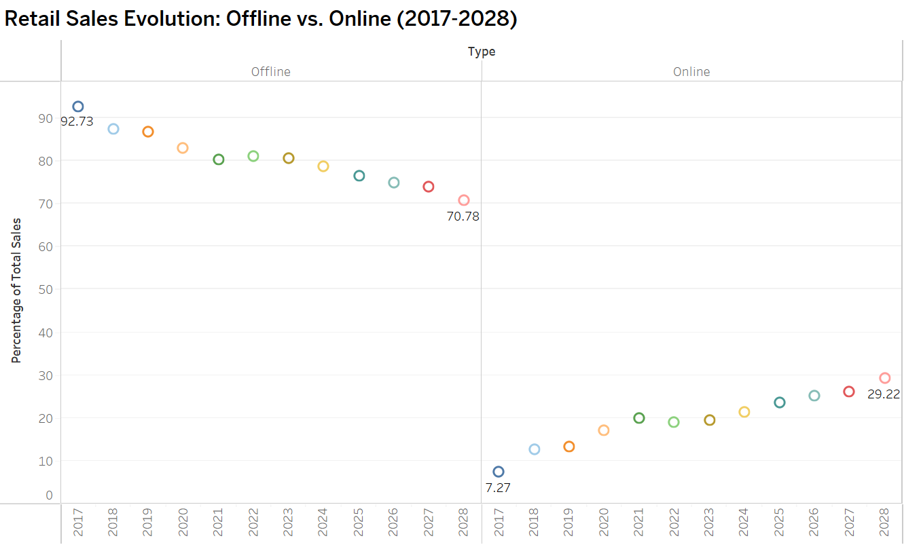
EDA 4

Slide 12
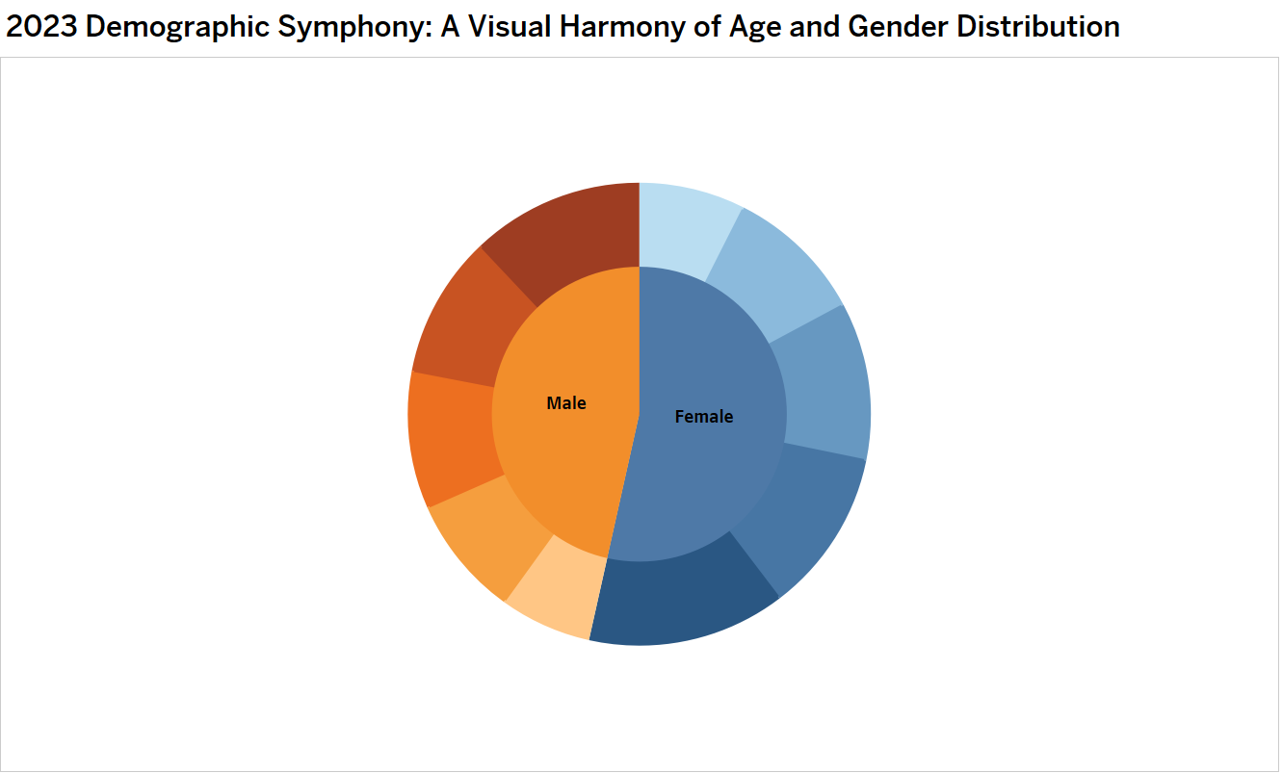
EDA 5

Slide 13
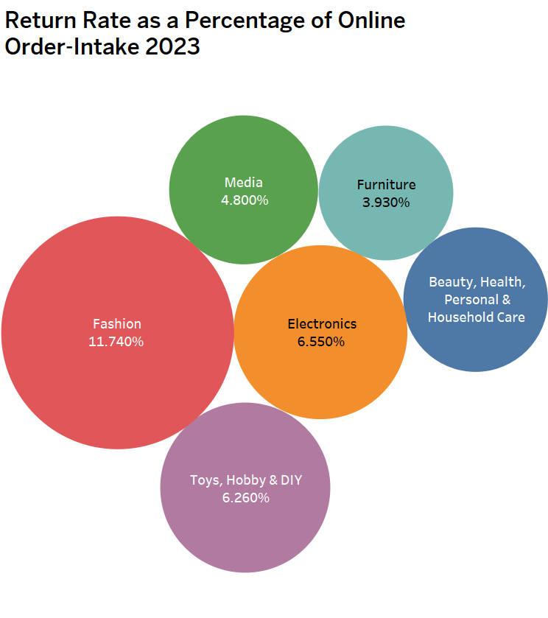
EDA 6

Slide 14
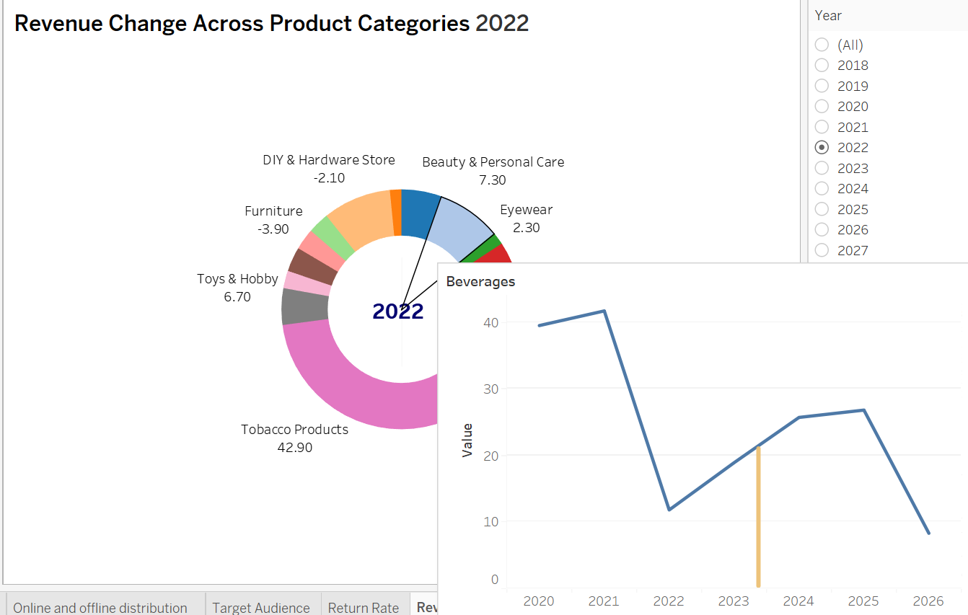
EDA 7

Slide 15


CONCLUSION
People keep buying more stuff online every year, and one thing that always makes a lot of money is selling clothes online. This is because fashion is always changing, and people love to keep up with the latest trends. Experts think that this trend of making more money from online shopping will continue to go up in the coming years.
The sales of electronic stuff dropped a lot by 12.50% in 2022 because of the COVID-19 pandemic causing a lot of problems. During the pandemic, some things sold more than usual, and some things sold less. But now, experts think that the ups and downs we saw won't last, and things will get more stable for online shopping in the future.
ReturnPal aims to expand in Canada in 2022 by partnering with major e-commerce players like Amazon and Walmart. This strategic move is expected to drive significant business growth by increasing visibility and establishing a strong foundation in the competitive Canadian online market.
ReturnPal is entering physical stores as 80% of consumers prefer offline shopping. This move is vital for success, helping them reach a significant group that favors traditional shopping, diversifying their customer base for greater success.
Our target audience are mostly female and male whos are is between 25-34 years.

Slide 16


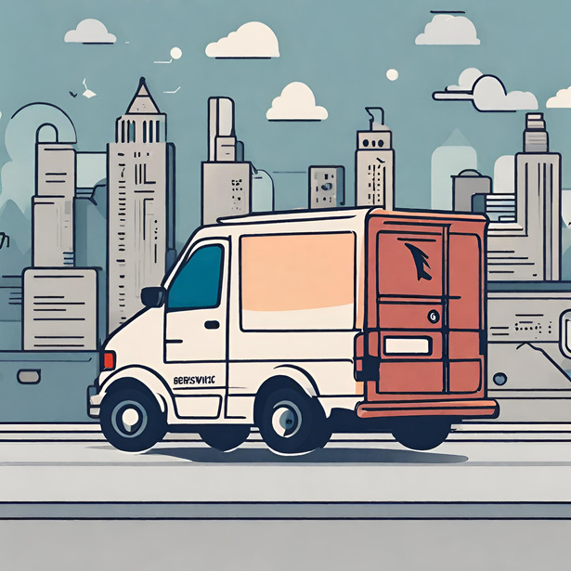

THANK'S FOR WATCHING

